Slide 1


Jay Patel

Slide 2
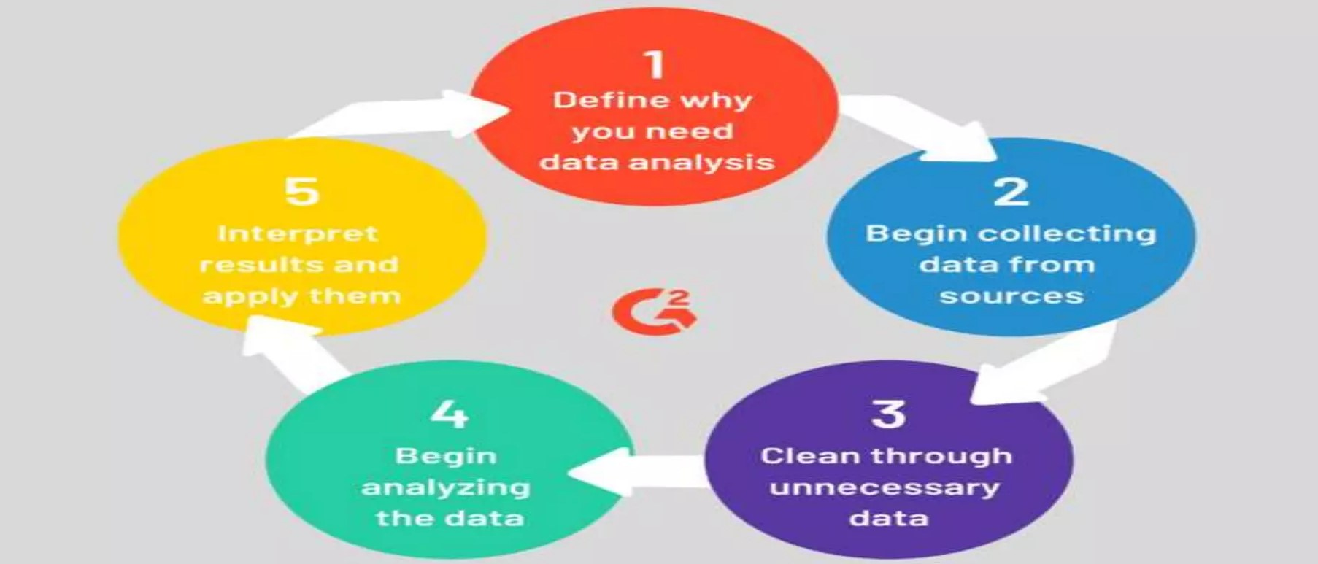
What is Data ?
What is Analytics ?
Data is simply facts or figures - bits of information.
When data is organized, processed, interpreted, structured to make it meaningful or useful, it is called complete information.
Data can be images, sounds, videos etc.
Data is measured, reported, and analyzed
can be structured or unstructured
can be discrete or continuous
It is the method of understanding or identifying or interpreting the hidden pattern in the data for effective . decision making.
STEPS OF DATA ANALYTICS
What is Data Analytics ?
It is the process of inspecting, cleaning, transforming and modelling data by using statistics

Slide 3
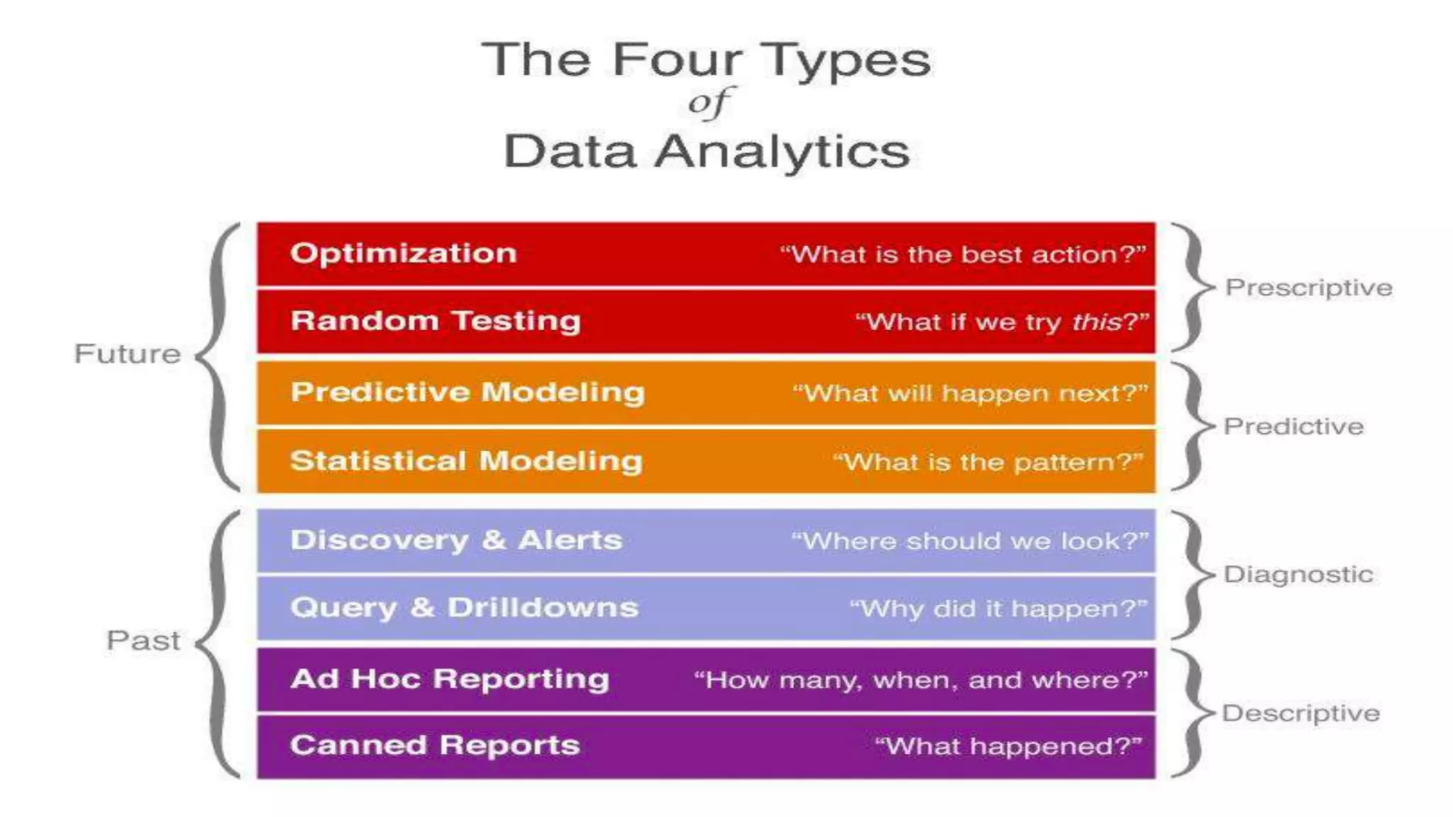

Slide 4
Types of
Data Analytics
Data analytics is broken down into four basic types.
Descriptive analytics: This describes what has happened over a given period of time. Have the number of views gone up? Are sales stronger this month than last?
Diagnostic analytics: This focuses more on why something happened. This involves more diverse data inputs and a bit of hypothesizing. Did the weather affect icecream sales? Did that latest marketing campaign impact sales?
Predictive analytics: This moves to what is likely going to happen in the near term. What happened to sales the last time we had a hot summer? How many weather models predict a hot summer this year?
Prescriptive analytics: This suggests a course of action. If the likelihood of a hot summer is measured as an average of these five weather models is above 58%, we should add an evening shift to the brewery and rent an additional tank to increase output.

Slide 5
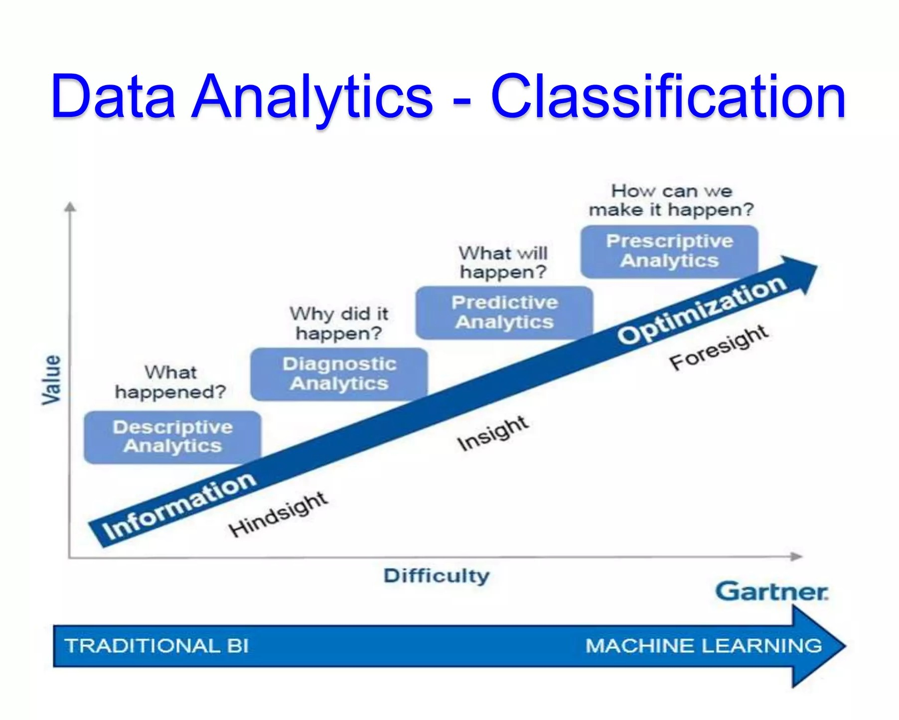

Slide 6
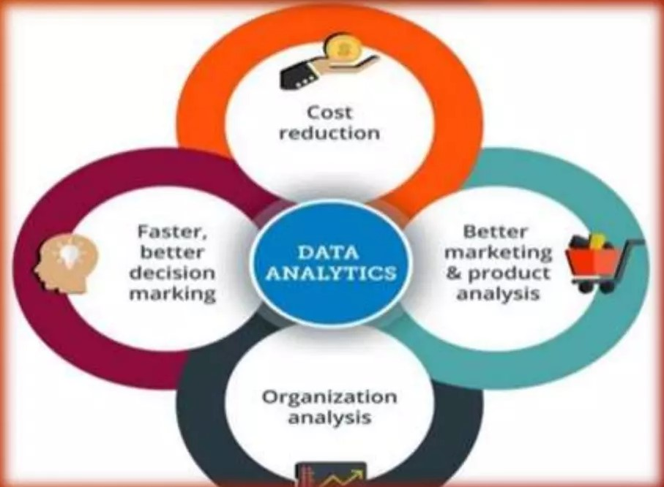
Why Data Analytics
Effective decision making
Enhanced customer service
Improves Business/sales
Identify anomalies

Slide 7
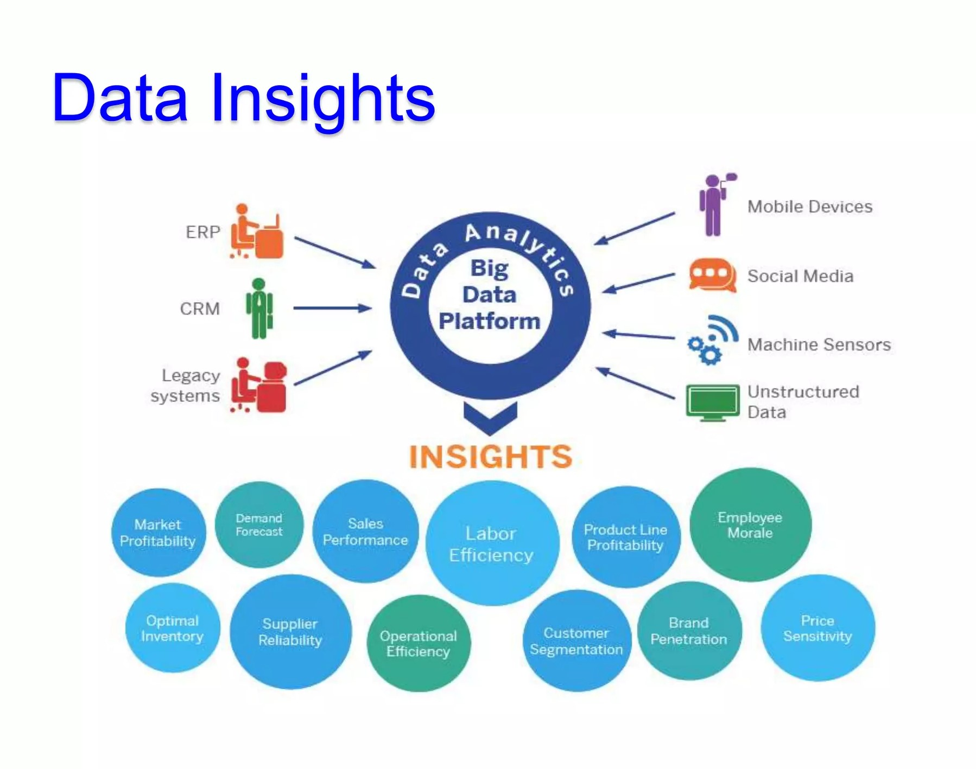

Slide 8
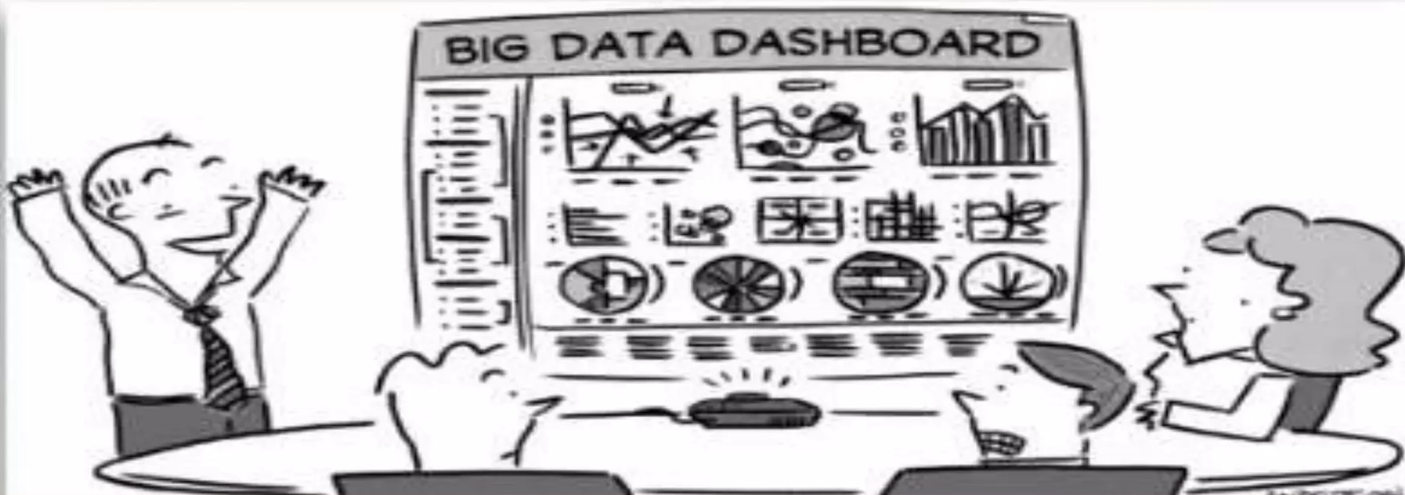
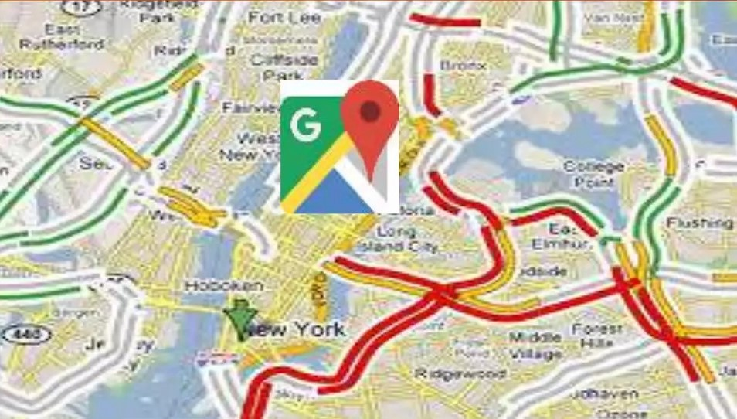

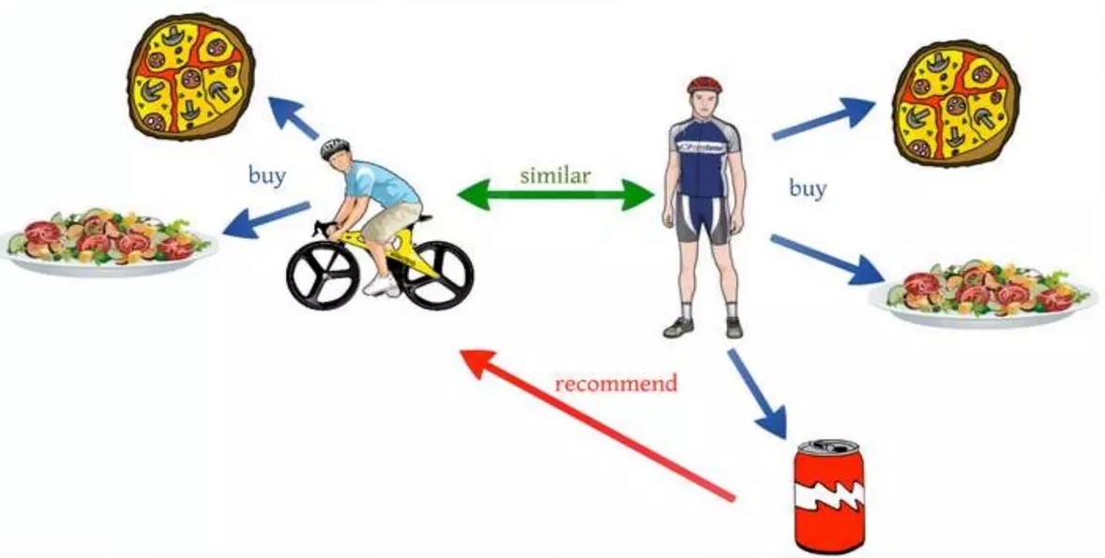

Applications of Data Analytics
Decision Making
Google Maps
Self Driving Cars
Recommendation Engine
Games

Slide 9
Activities in Data Analytics
Data Extraction - Fetch data from database
Data Analysis - Observe the data
Data Manipulation - Manipulate the data
Data Modelling - Fit a model to the data
Data Visualization - Visualize the data

Slide 10
Career in Data Analytics
Data Engineer
Data Analyst
Data Modeler
Data Scientist
Full stack developer

Slide 11
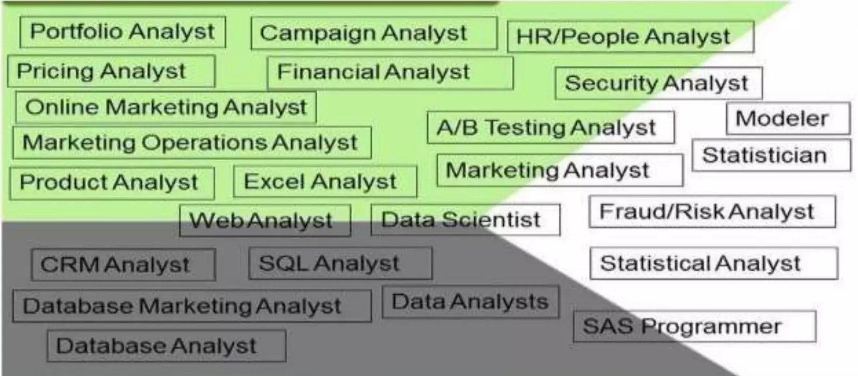
Roles in Data Analytics

Slide 12
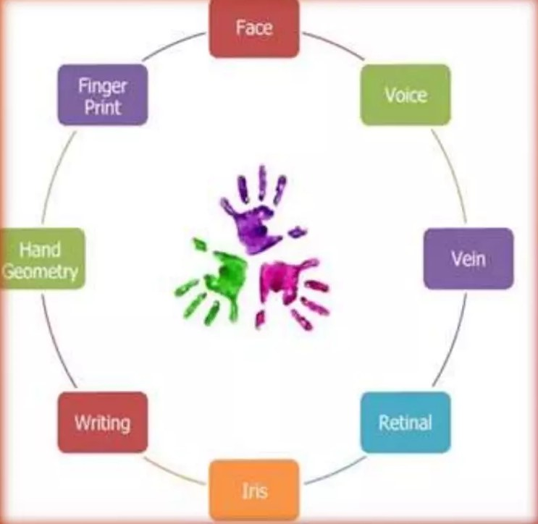
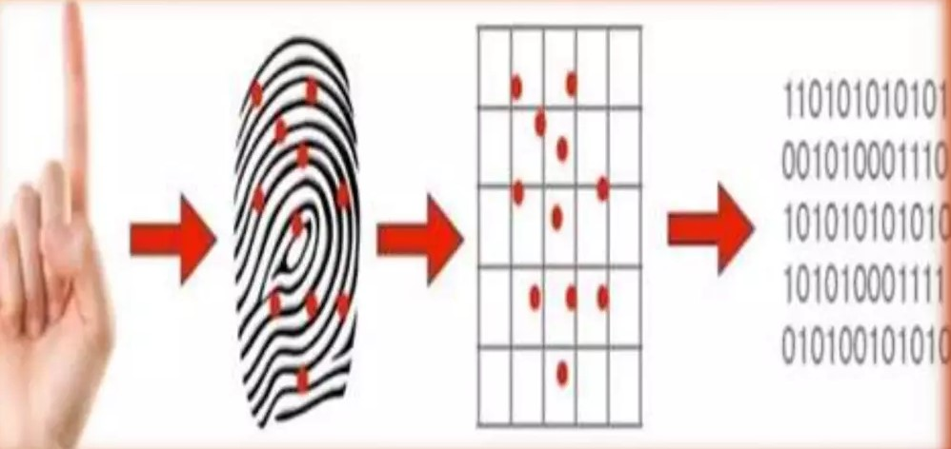

USE CASE
Aadhar
YouTube
YouTube uses recommendation systems to bring videos to a user.
Increases the time user spends in the site
Makes money by advertising
Entertains the user
Ultimately became popular

Slide 13
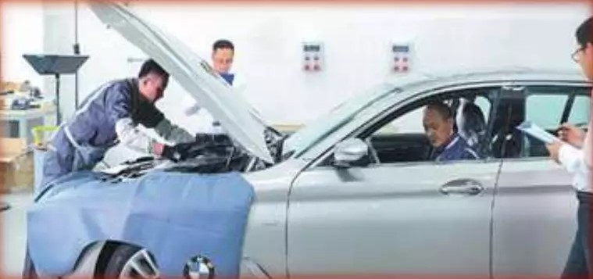
BMW
Sensors are installed in the car to monitor the condition of the vehicle
BMW gets the data continuously, analyses it to understand the condition of the car
Customer is contacted when the car needs service
Other
Identifying fraudulent banking transactions
Determining a defaulter before issuing a credit card
Advertising a brand on T-Shirts - FIFA
Customer churn - Telecommunication

Slide 14
Tools available in Data Analytics
Data Analysis & Modelling
Data visualization
Python
R
SAS
SPSS
IBM WATSON
MATLAB
Statistica
WEKA
MS Excel
Power BI
COGNOS
QlikView
Tableau
Excel
Python
Dueen
Domo
BIRT
JaperSoft
SpagoBl
Pentaho

Slide 15
Thank You

